Slide 1
Evolution of porosity, permeability and pore structure in mudstones upon fluid injection
Harsh Biren Vora
Dr. Brandon Dugan

Slide 2
Fluid Injections in Mudstones
Motivation
Effective Stress
Lattice Boltzmann Modeling of Mudstone Permeability
Experimental results of fluid injection tests
Conclusions
Future Work

Slide 3
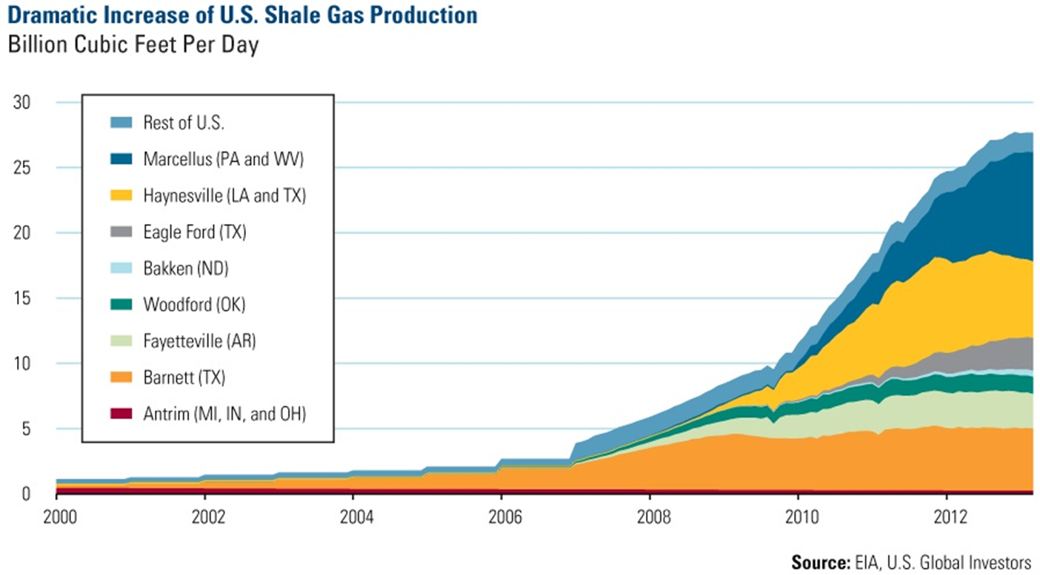
Why study fluid injection ?
www.eia.gov
Notes:
Wastewater injection

Slide 4
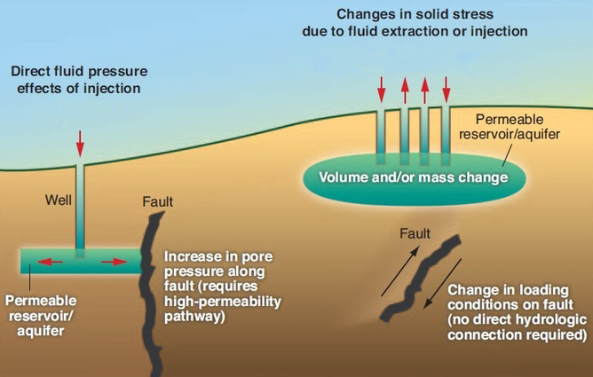
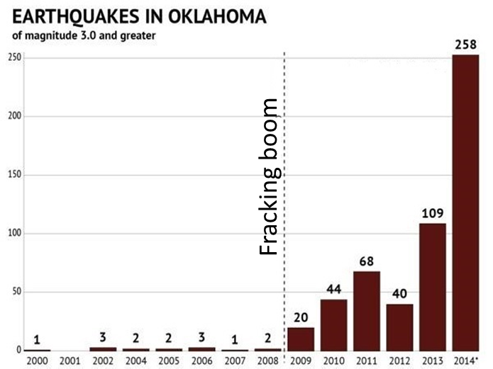
Why study fluid injection ?
Problems associated with fluid injection:
Induced seismicity,
triggering of faults
contamination of water reserves
Only 25-60 % of injected water is recovered at the surface (Gregory et. al, 2011; O’Malley et. al, 2016)
Renewed interest in shales as hydrocarbon reservoirs
Mudstones and shales make up 60% of sedimentary record (Pettijohn, 1957)
Oklahoma Geological Survey
Notes:
Natural processes also cause unloading – heating, charging of reservoirs, hydrocarbon maturation, erosion and clay diagenesis

Slide 5
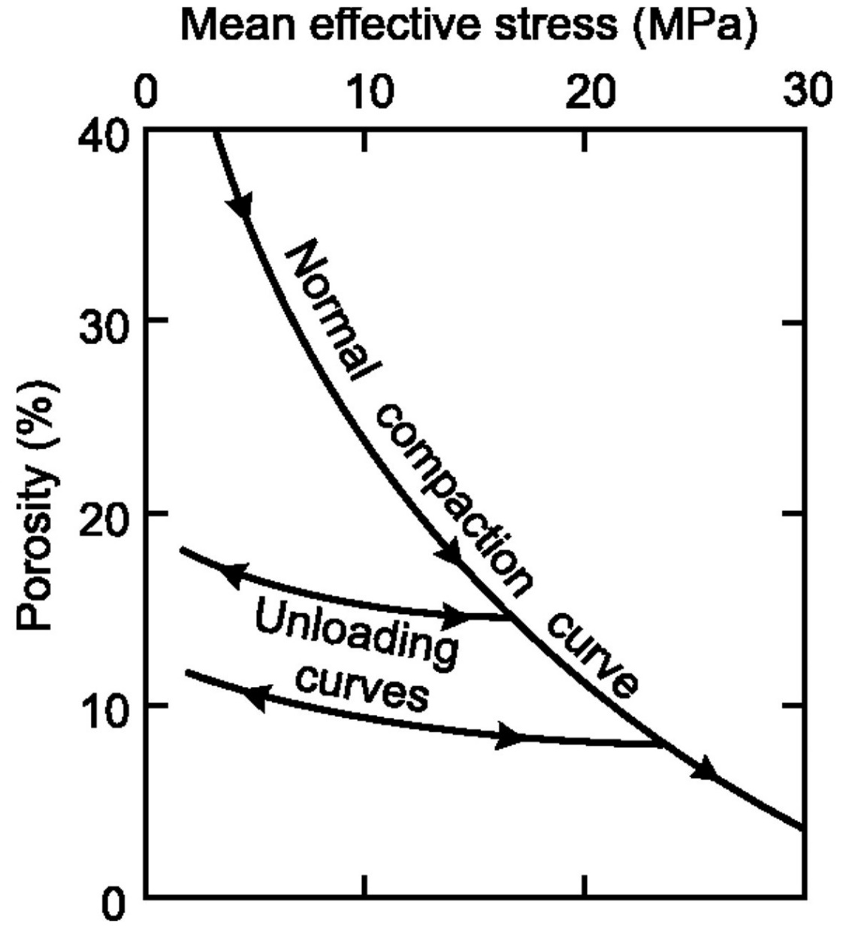
Effective Stress Law
σ_{eff} = σ_{V} - P_{p}
σ_{eff} : Effective stress
σ_{V} : Overburden stress
P_{p}: Pore pressure
Increasing σ_{eff} : Loading
Decreasing σ_{eff:} Unloading
Goulty, 2002
Notes:
Fluid injection is a process of unloading
Natural processes also cause unloading – heating, charging of reservoirs, hydrocarbon maturation, erosion and clay diagenesis

Slide 6
Objectives
How do petrophysical signatures - k, φ, Vp and Vs – evolve upon unloading induced from fluid injection ?
Understand evolution of pore structure in mudstones upon fluid injection
Are there predictable pathways of accommodation of injected fluid in mudstones ?
Notes:
What are the intermediate states of injection ?

Slide 7
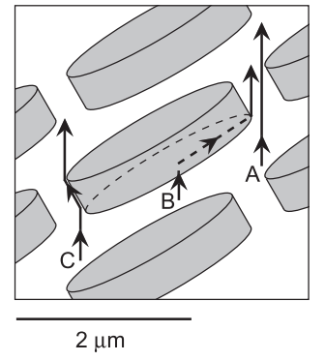
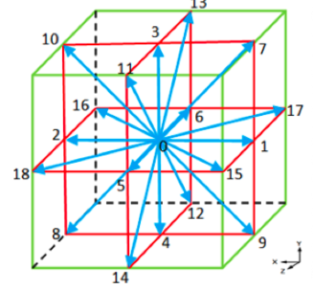
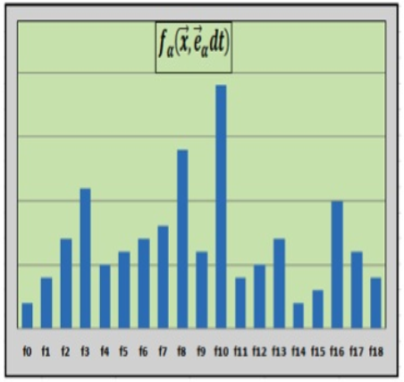
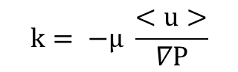
Methods – Lattice Boltzmann
$$k= −µ \frac{<u>}{∇P}$$
k = permeability
<u> = flow velocity for unit length
ΔP = Pressure gradient
Daigle and Dugan, 2011
Chuckwudzoe, 2011
Notes:
Top and bottom constant pressure boundaries
Bounce back scheme on sides

Slide 8
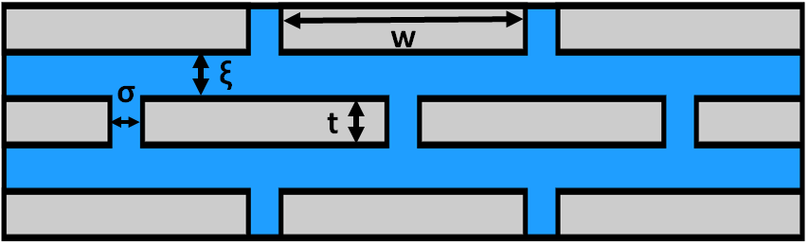
LBM – Initial Model
0.05 μm
2 μm
w: grain width
t: grain thickness
ξ: inter-bed pore diameter (=t)
σ : pore throat diameter (=0.5*t)
φ_{i} = 0.07
k_{H} = 406 nD
K_{V} = 10.3 nD

Slide 9
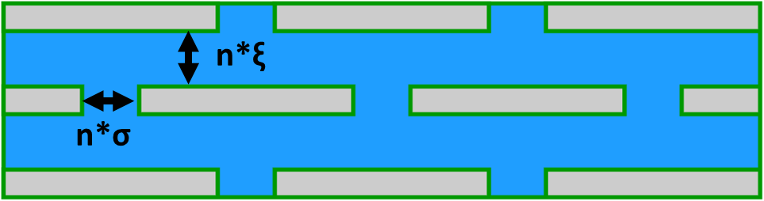
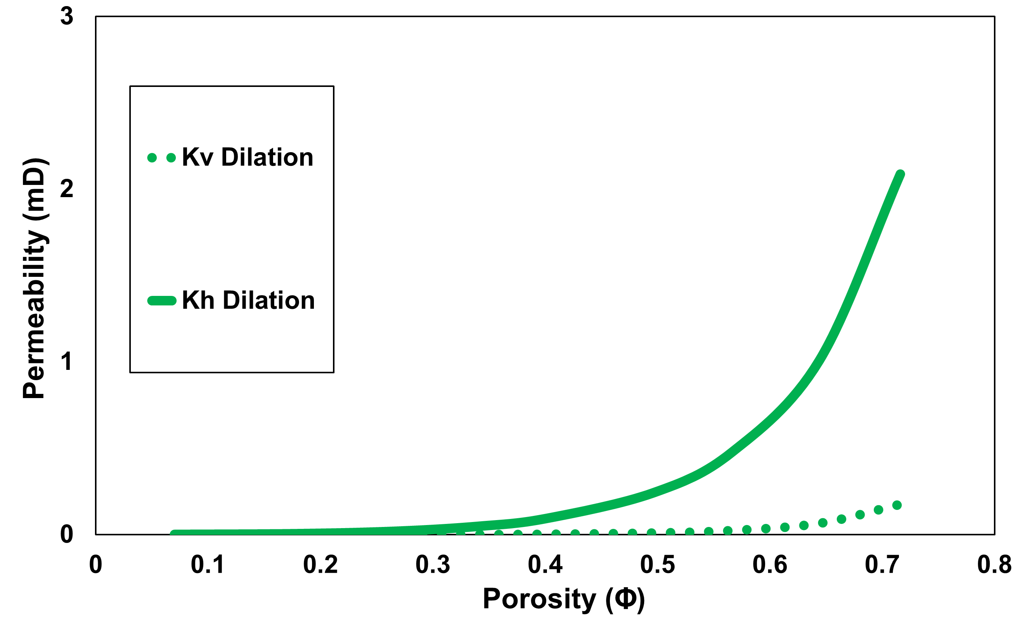
LBM – Isotropic Expansion
Injection affects all pores uniformly
Notes:
Elastic behavior

Slide 10
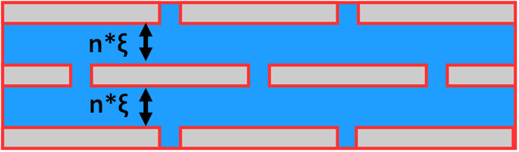
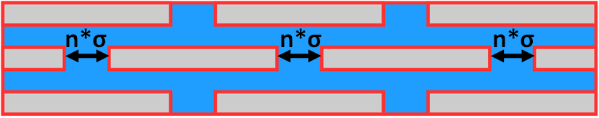
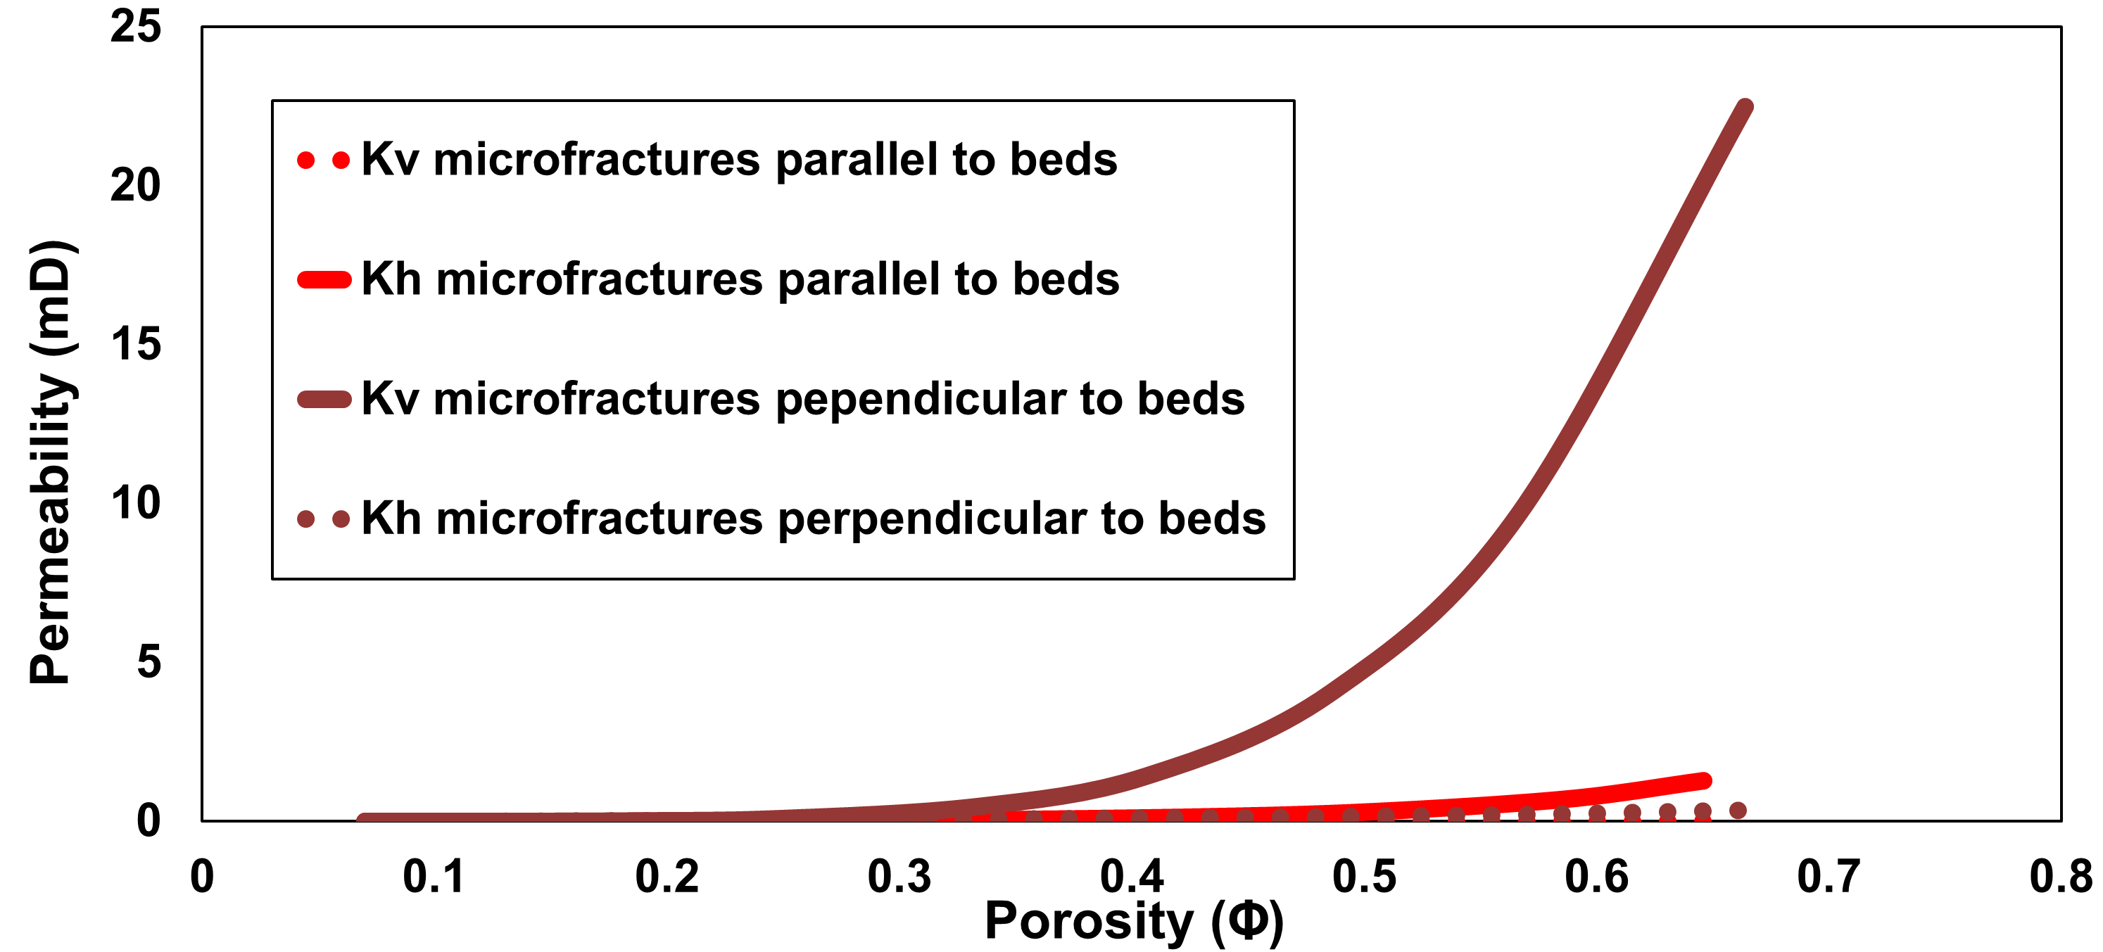
LBM – Micro-fracture growth
Opening of pore throats Expansion of interbed pores

Slide 11
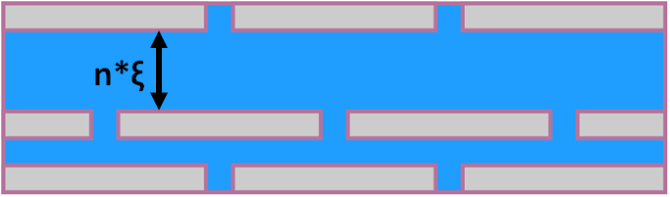
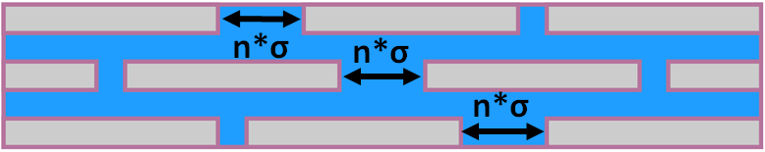
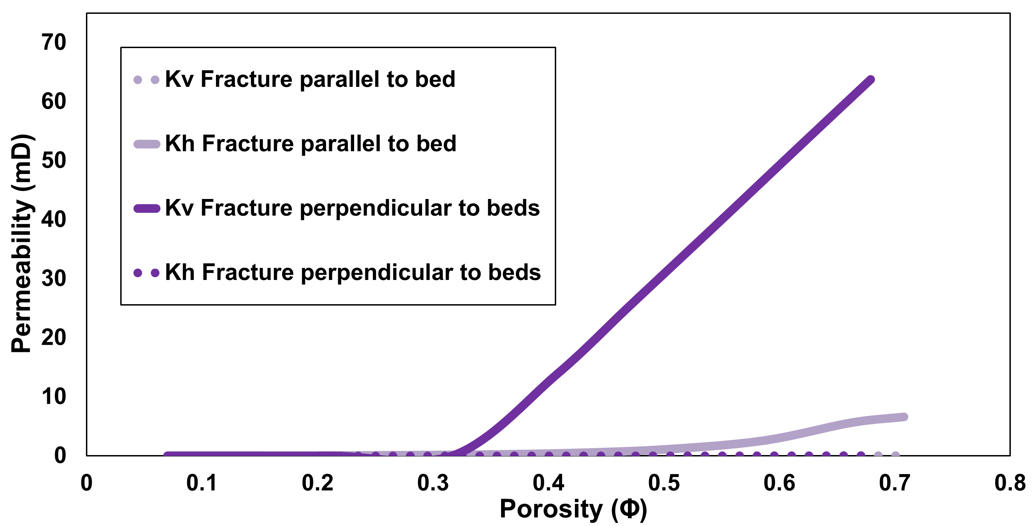
LBM – Fracture Propagation
Formation of high-conductivity pathway

Slide 12
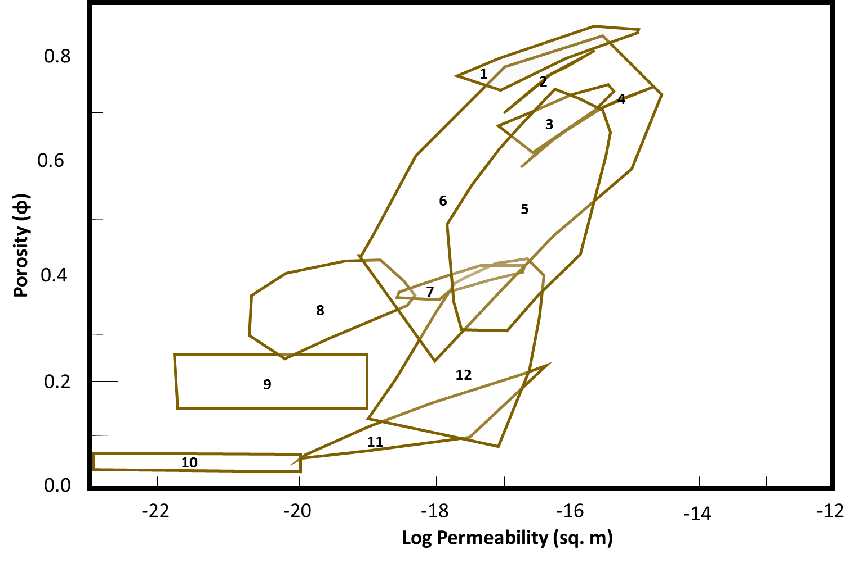
LBM Results
φ_{i} = 7%
Modified from Neuzil, 1994
Notes:
Comparable with contemporary results
Left of dilation/compaction line: storage parallel to bedding
Right of dilation/compaction line: storage perpendicular to bedding
Scale independence

Slide 13
Takeaways from LBM Models
Model analogs for fluid injection yield permeability results comparable to contemporary data (Neuzil, 1994)
Φ vs k response changes significantly depending on dominating mechanism of accommodation of injected fluid
Developed LB model framework can be applied to experimental measurements of φ and k to predict pore structure evolution upon fluid injection
Notes:
Resolvable by laboratory experiments

Slide 14
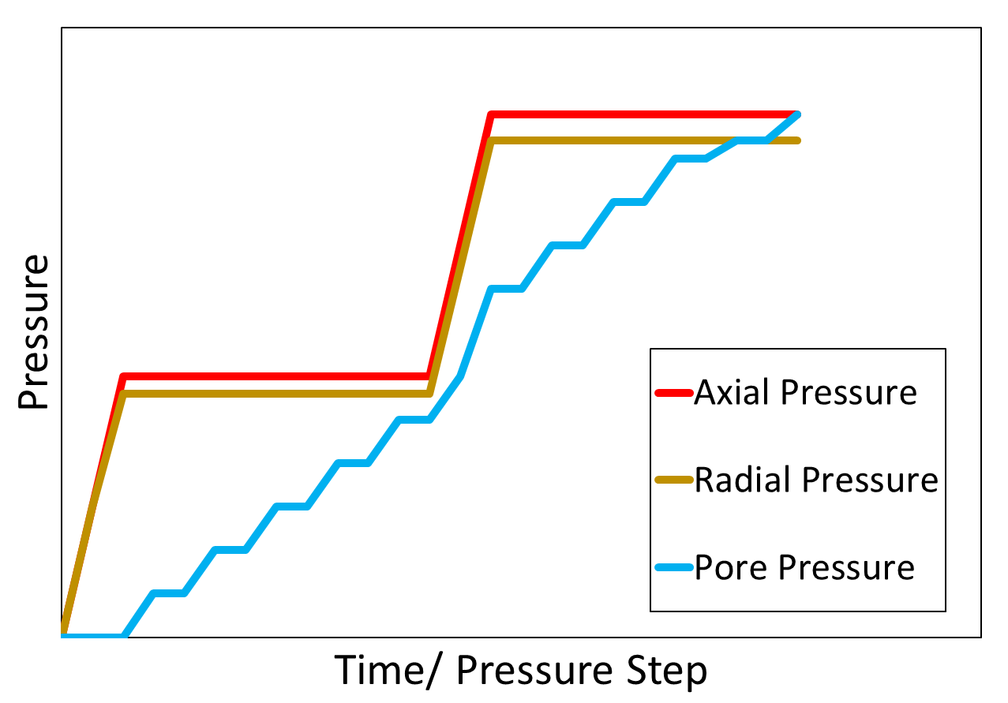
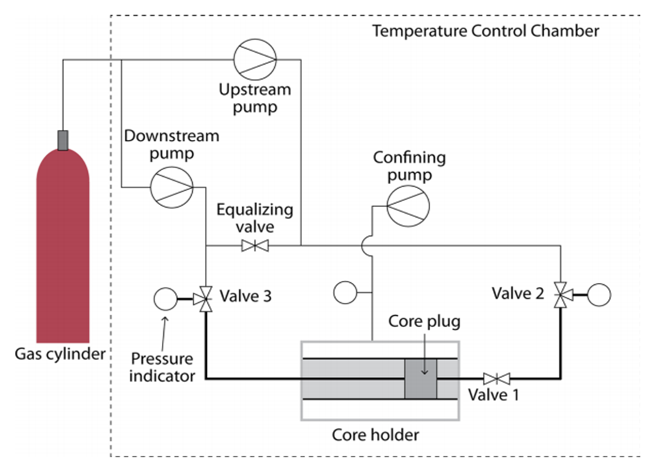
Experimental Methods
Petrophysical measurements:
Porosity (φ)
Permeability (k)
Acoustic velocity (Vp and Vs)
Bhandari et. al., 2015

Slide 15
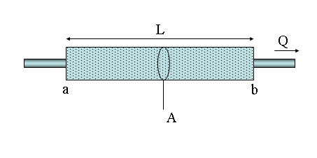
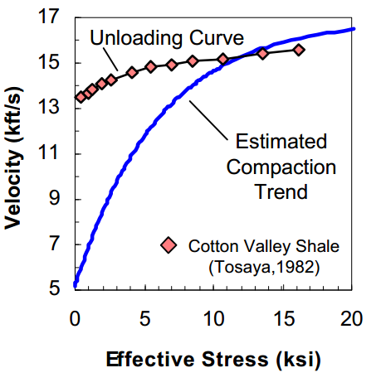
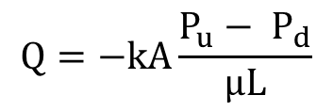
Experimental Methods
Permeability (k)
Velocity (Vp and Vs)
P_{U}
P_{D}
$$Q=−kA\frac{P_{u}− P_{d}}{µL}$$
Q = flowrate (m³/s)
k= permeability (m²)
P_{u}= Upstream Pressure (Pa)
P_{d} = Downstream Pressure (Pa)
µ = Viscosity (Pa.s)
L = length of sample (m)
Vp more sensitive than Vs to fluid pressure
Vp and Vs are sensitive to pore structure changes
(Mavko et. al, 2009)
Darcy, 1856
Bowers, 2005
Notes:
Porosity is measured from injected fluid volume, fluid used is distilled water
P wave velocities tend to be more sensitive to pore fluid pressure, S to structural changes

Slide 16
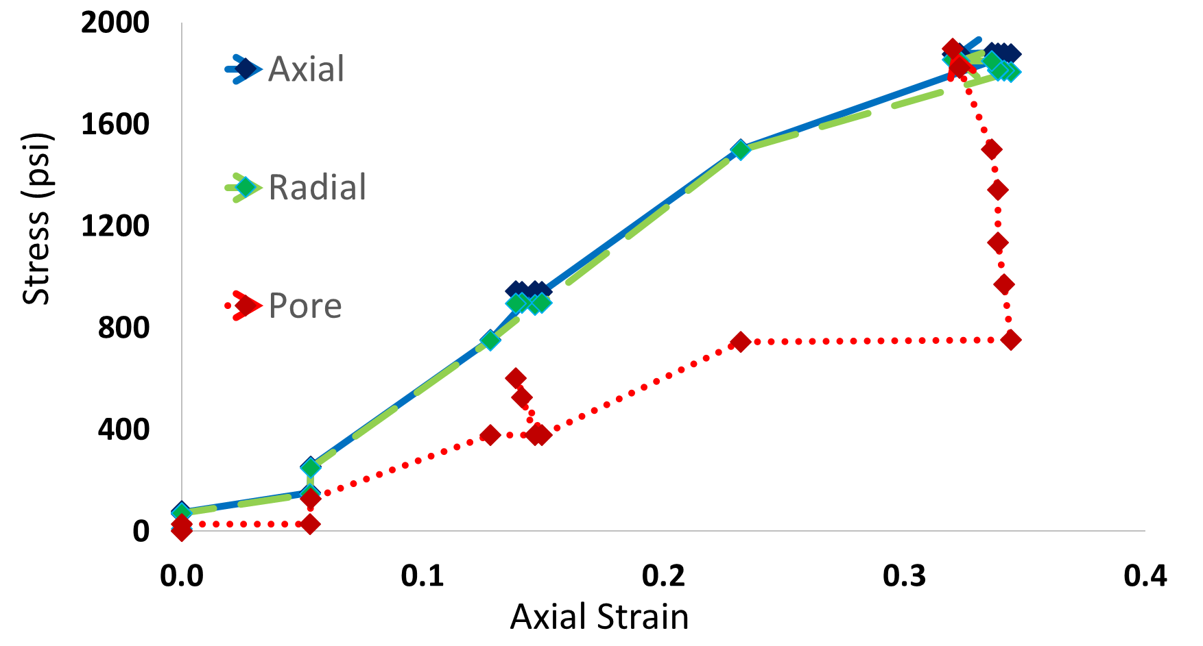
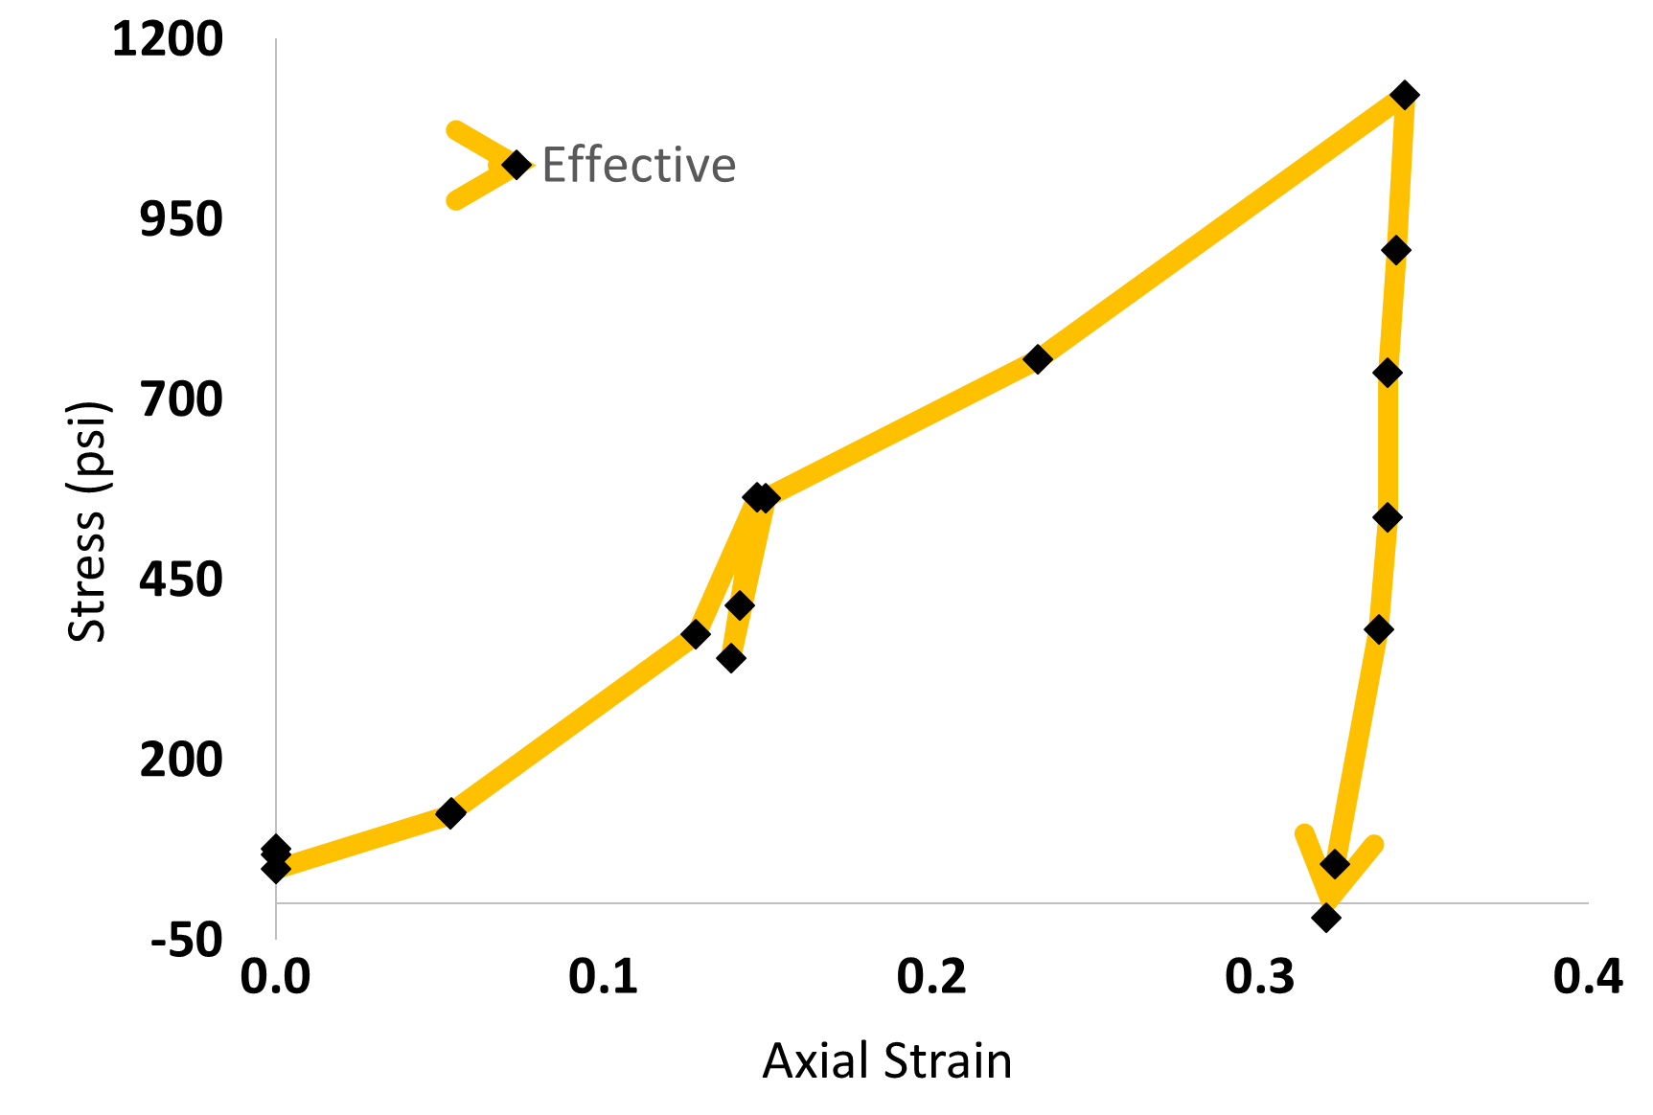
Experimental and Core Details
Core Details
IODP 308-1324B-3H4
Depth = 18.4 mbsf
Insitu Stress = 60.352 psi
φ_{i} = 65 %
Clay = 63.3 %
Silt = 36.6%
Sand = 0.1%
Notes:
B tests

Slide 17
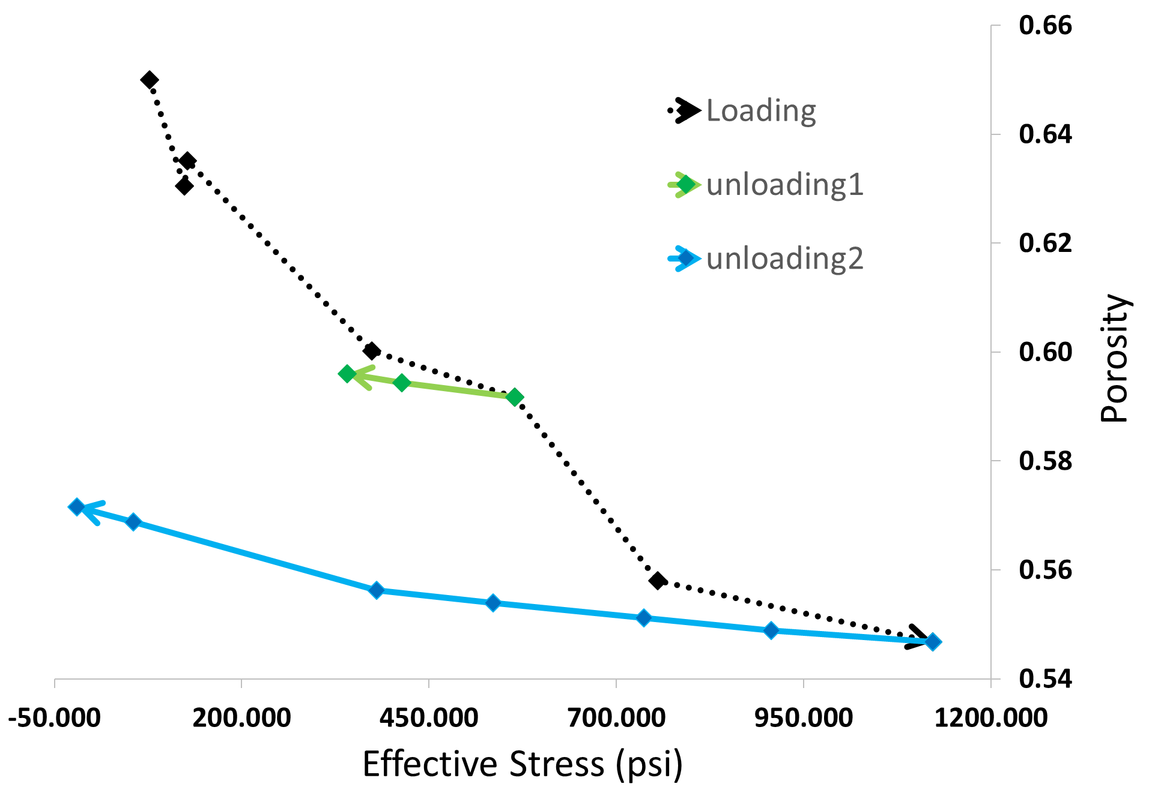
Fluid Injection trends
Notes:
Explain injection zones

Slide 18
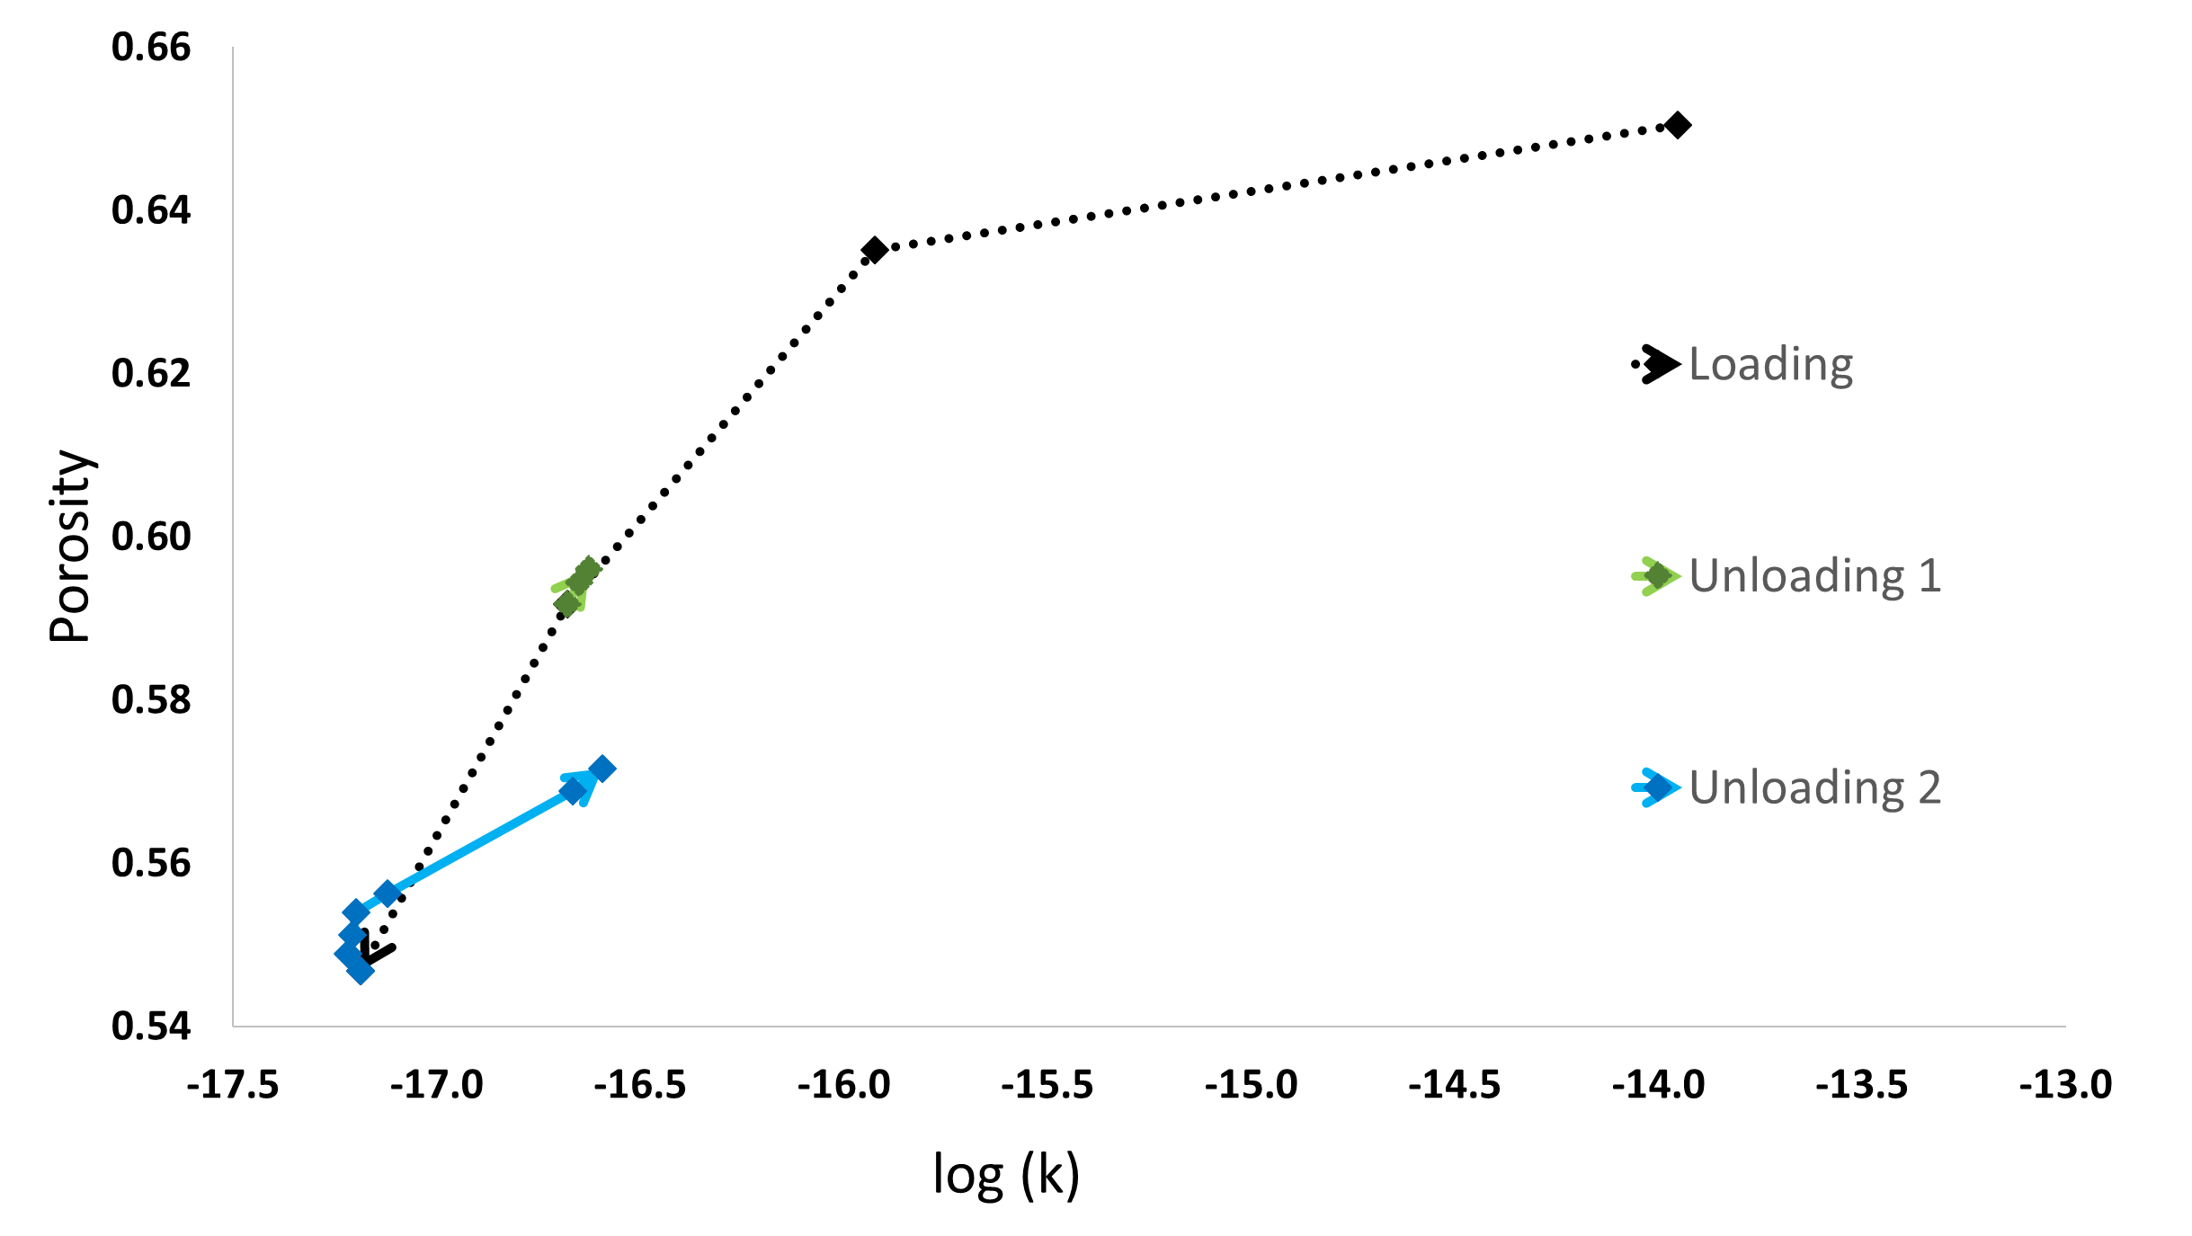
Porosity – Permeability trends
Notes:
K is not a simple function of effective stress or proosity

Slide 19
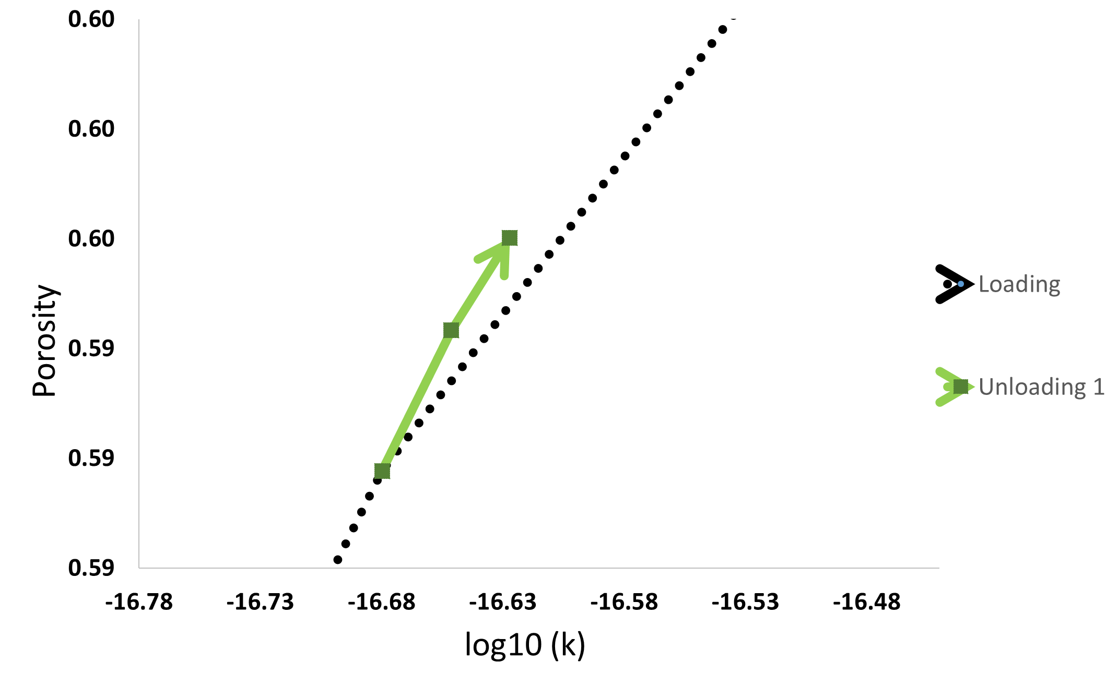
Unloading Stage 1
Notes:
Left of dilation – fluid stored parallel to bedding
Vp more sensitive than Vs – fluid pressure

Slide 20
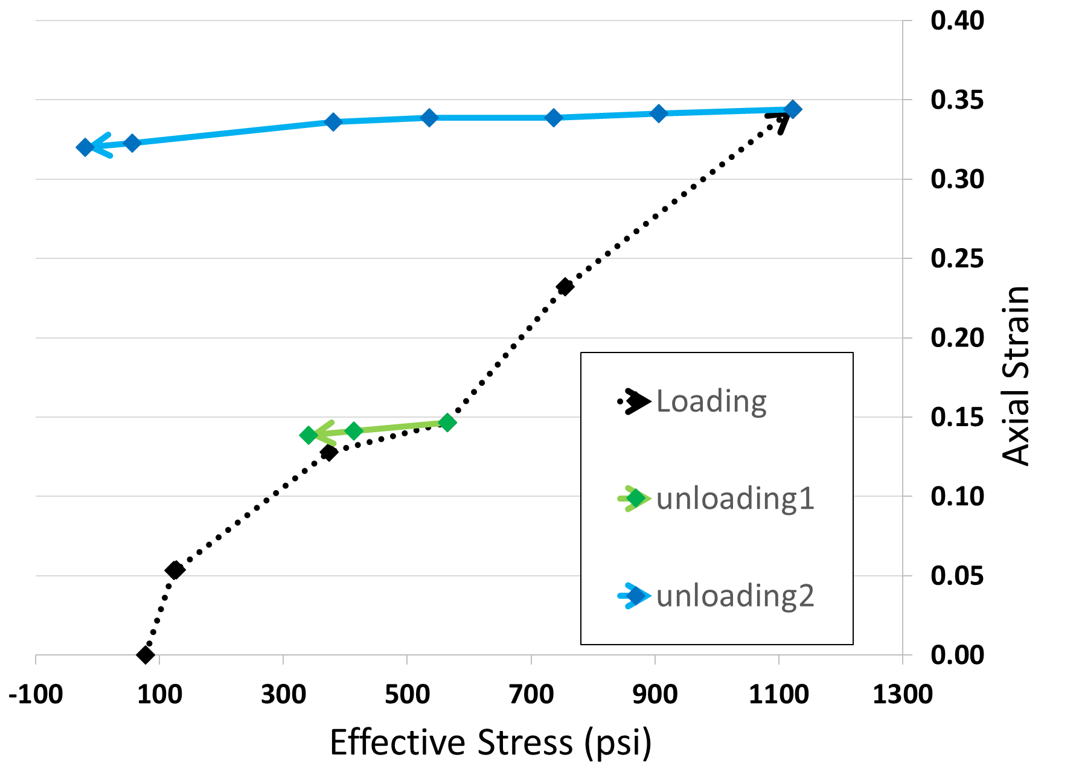
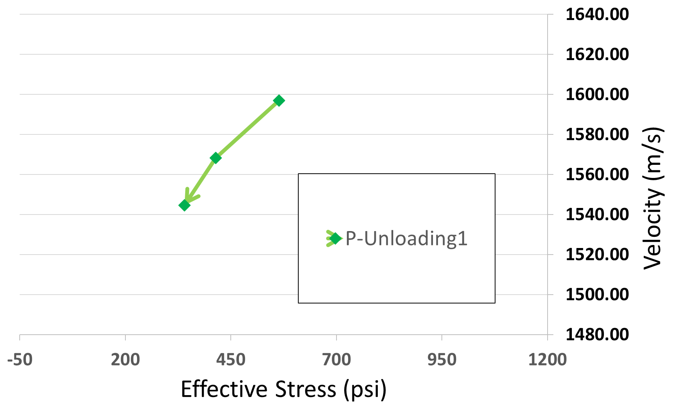
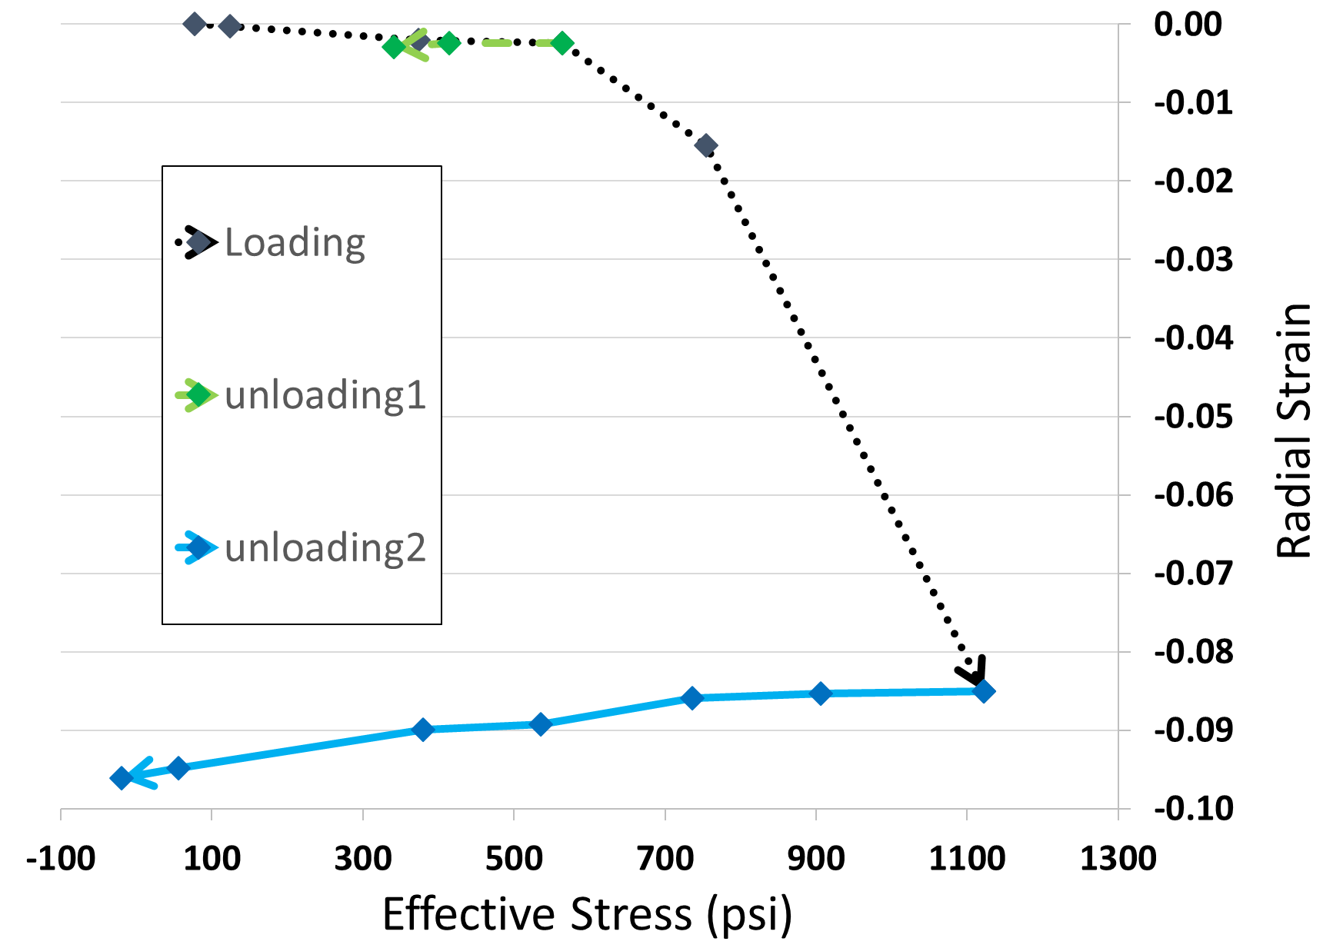
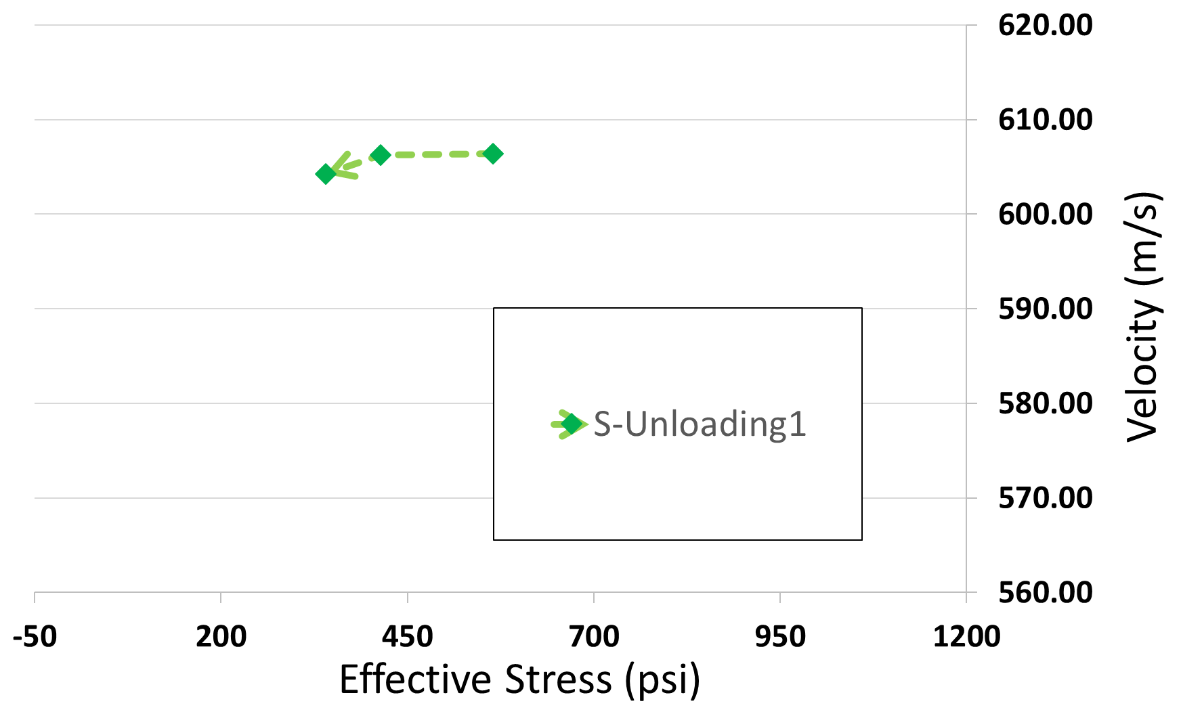
Unloading Stage 1
Notes:
No significant change in structure

Slide 21
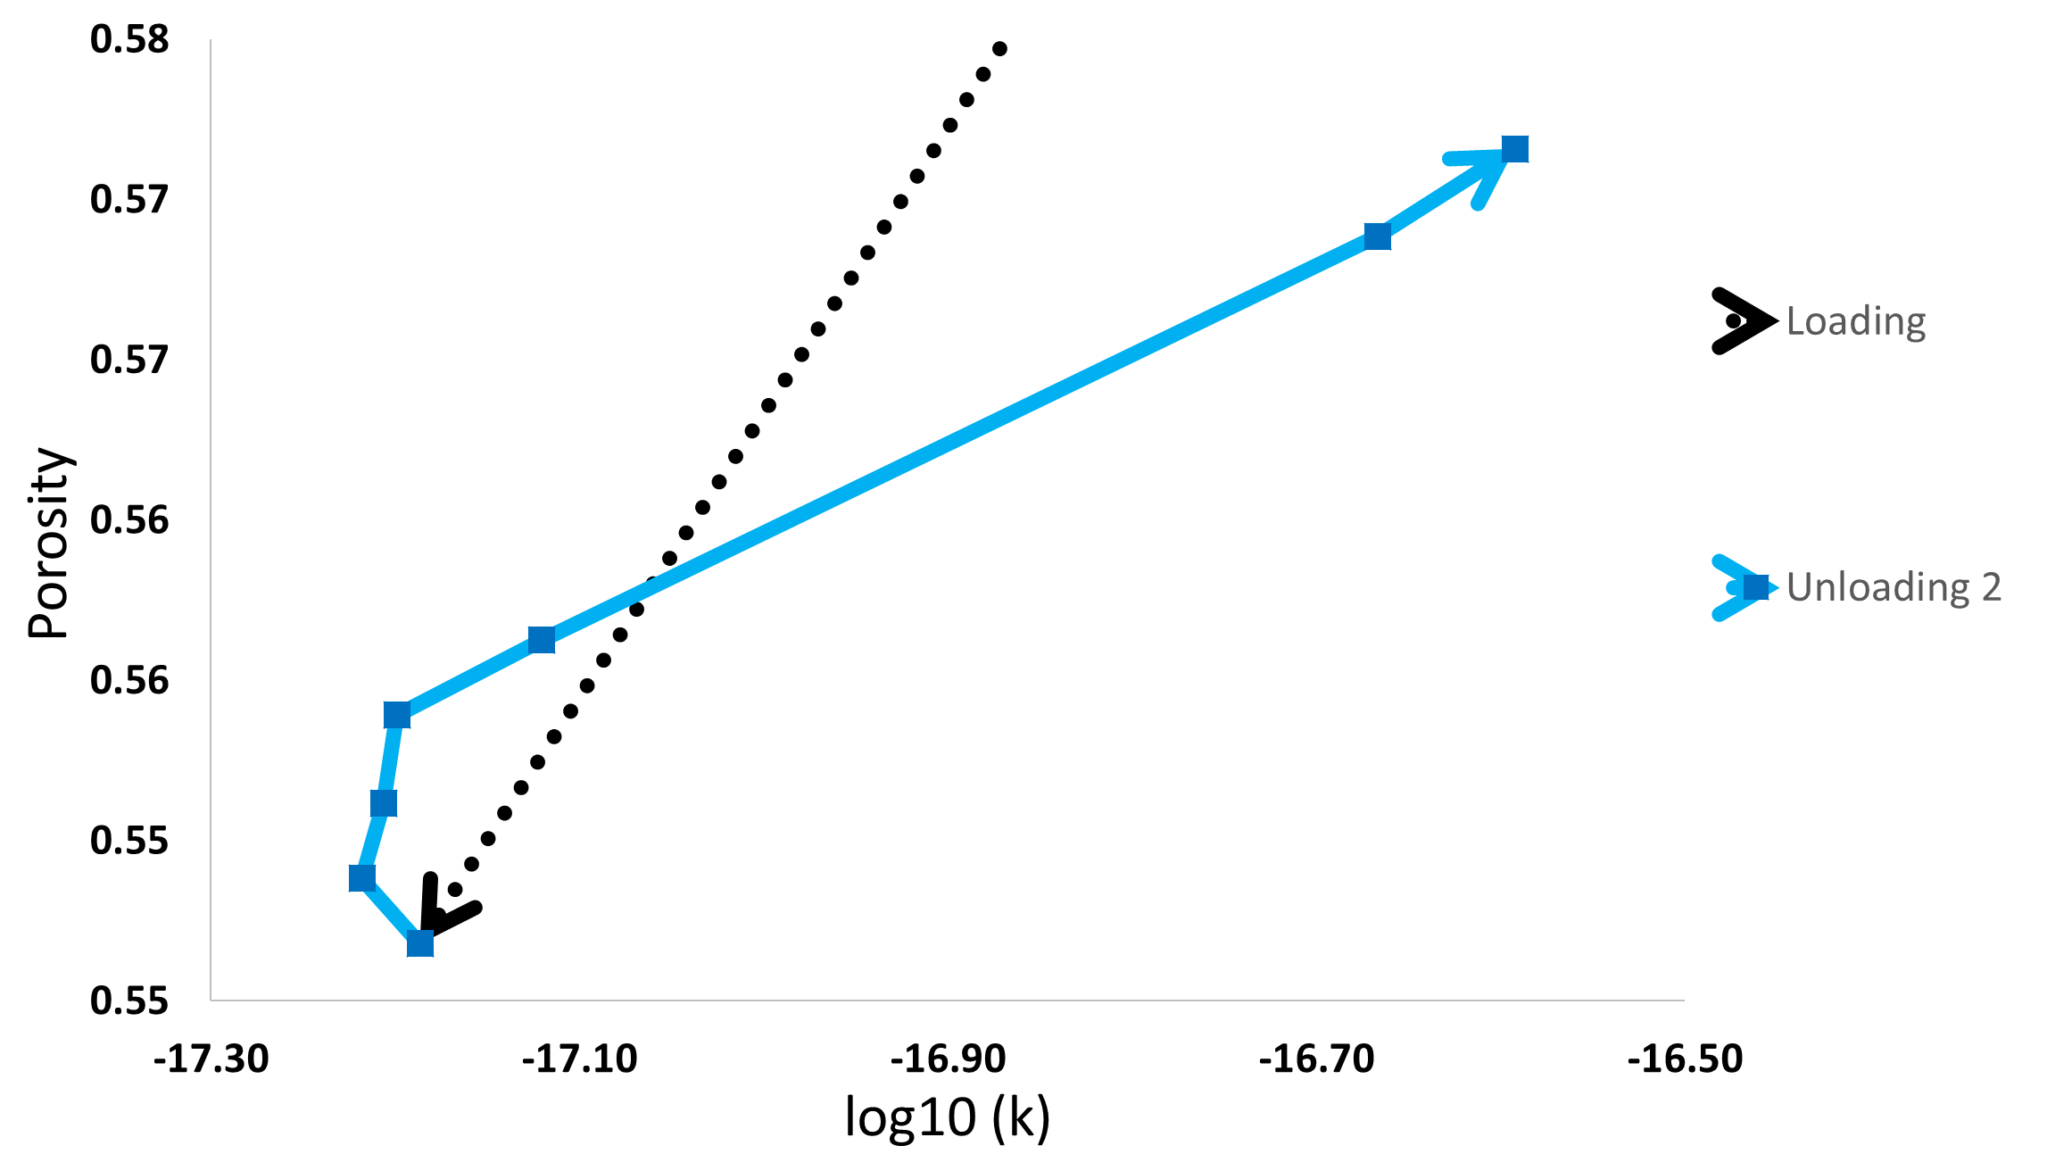
Unloading Stage 2
Notes:
Velocity
Fracture porosity

Slide 22
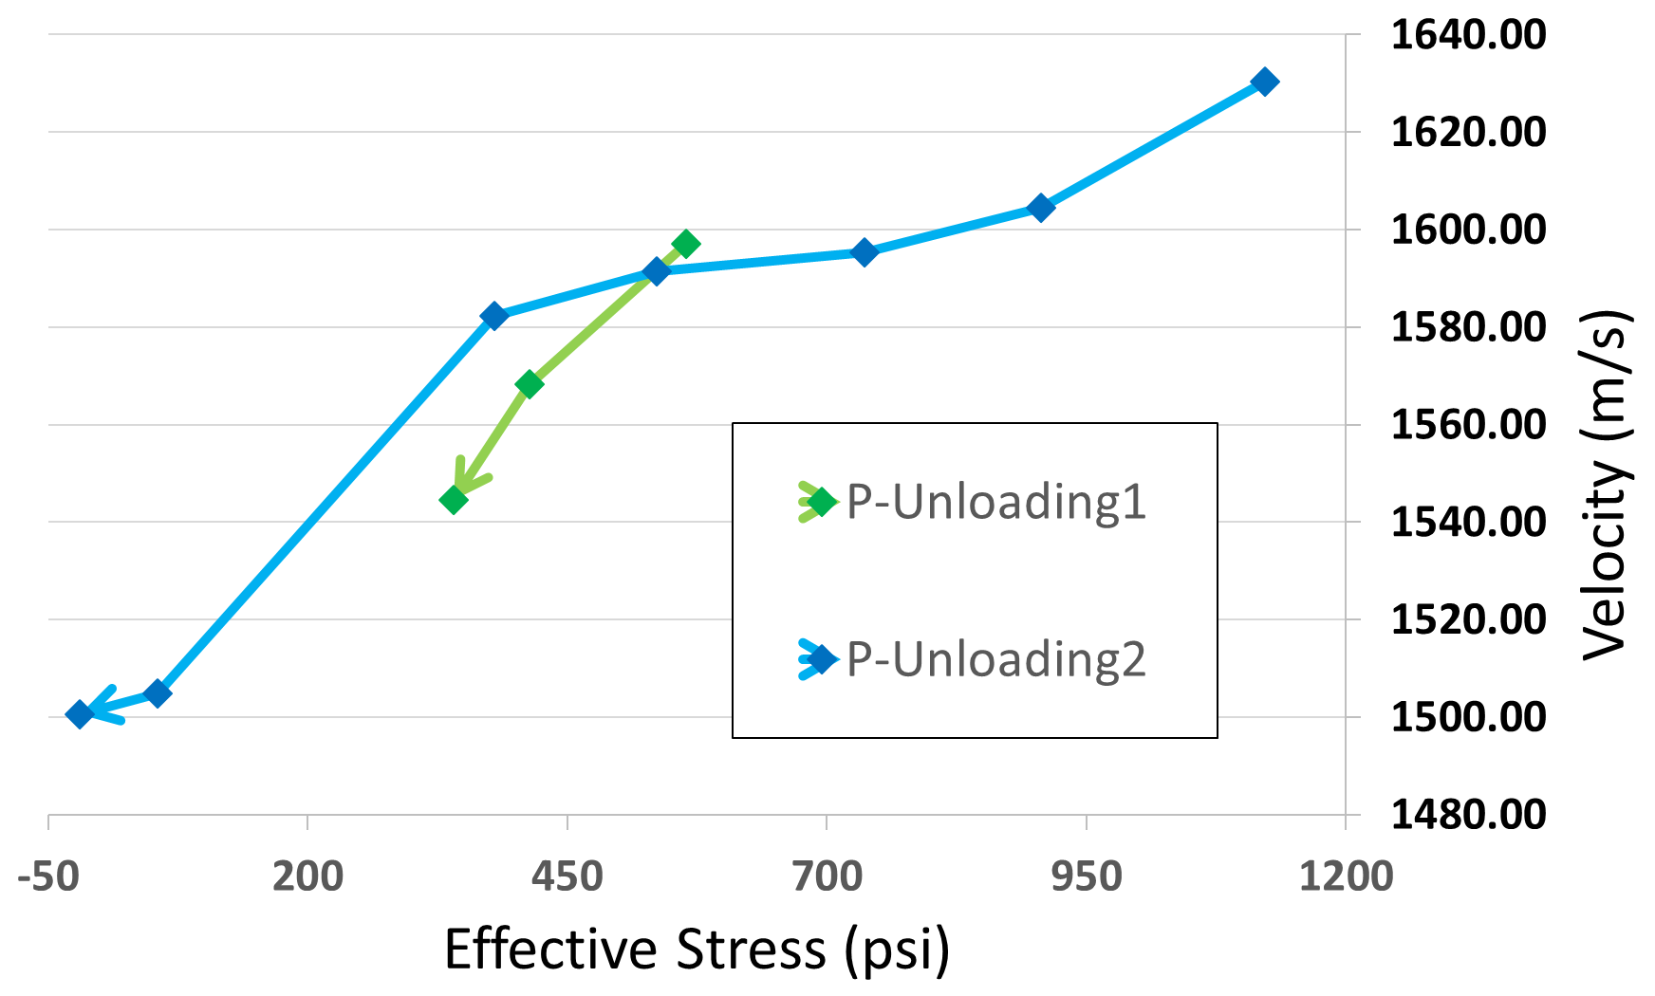
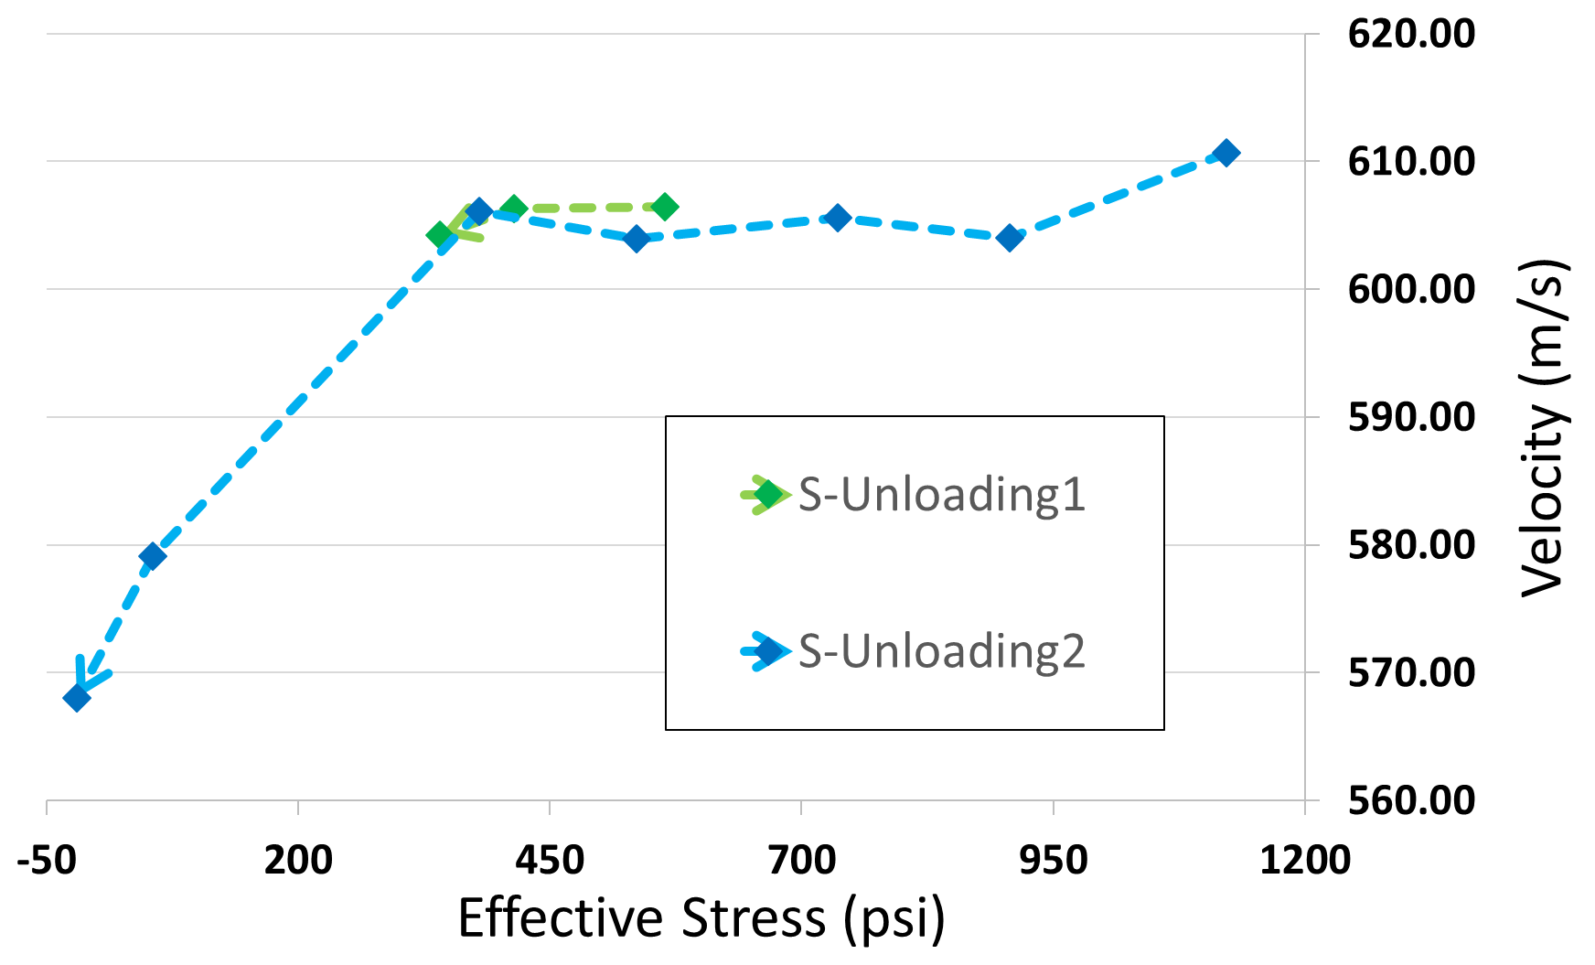
Unloading Stage 2
Notes:
No significant change in structure

Slide 23
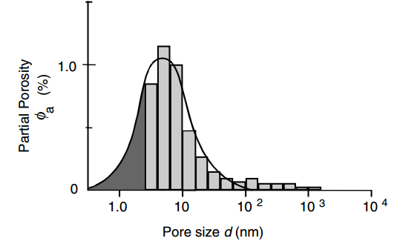
Future Work: NMR
NMR helps understand the pore-size distribution in rock
Katsube, 2000
Notes:
Methodology of NMR acquisition
Pore structure

Slide 24
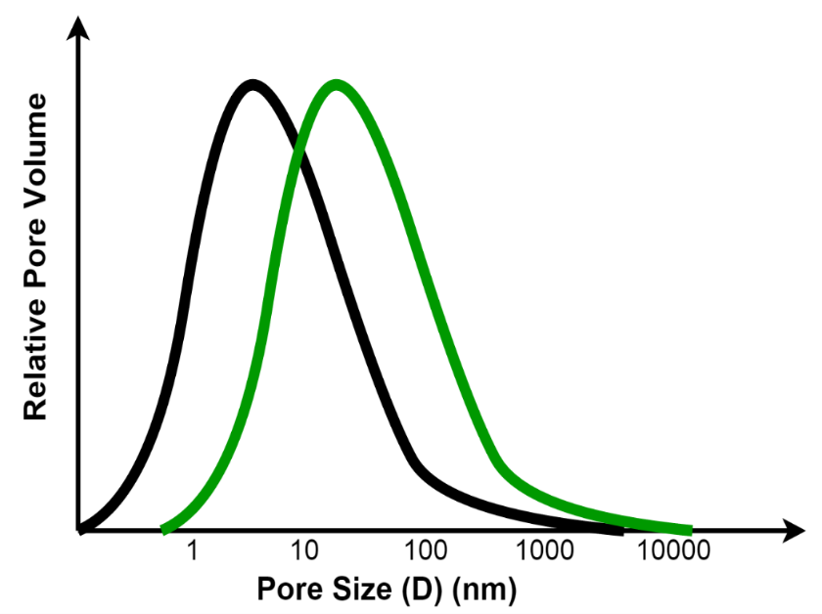
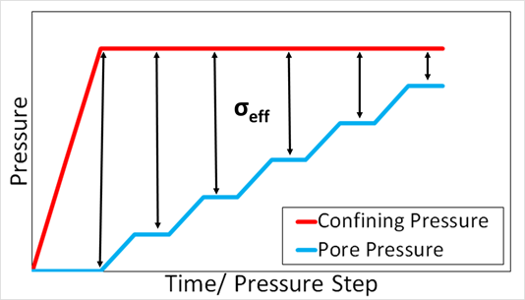
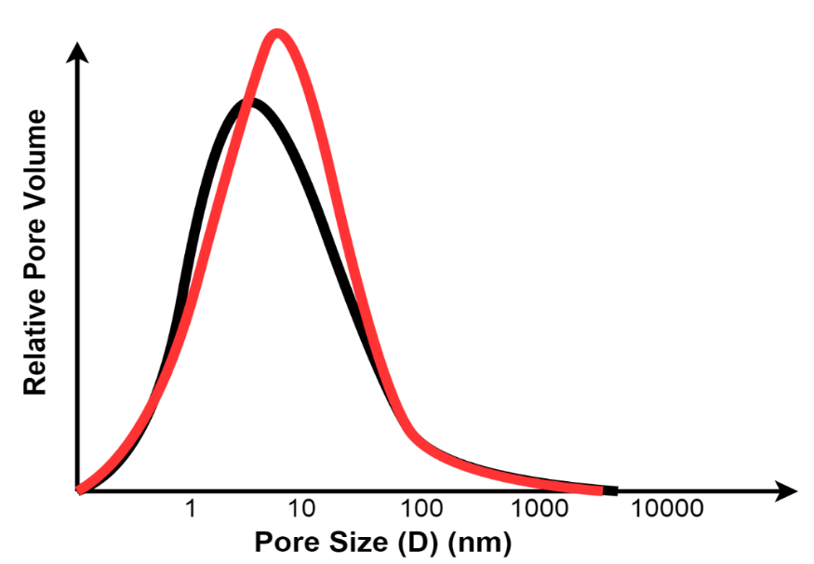
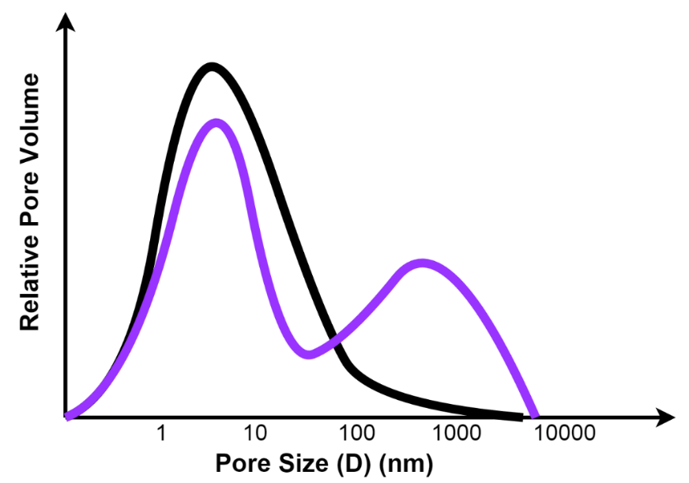
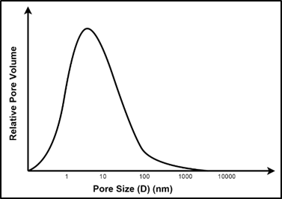
Future Work: NMR
Dilation
Correlation between developed model analogs and experimental results can be verified by imaging pore structure evolution
Micro-fracture growth
Fracture propagation
Initial NMR signature

Slide 25
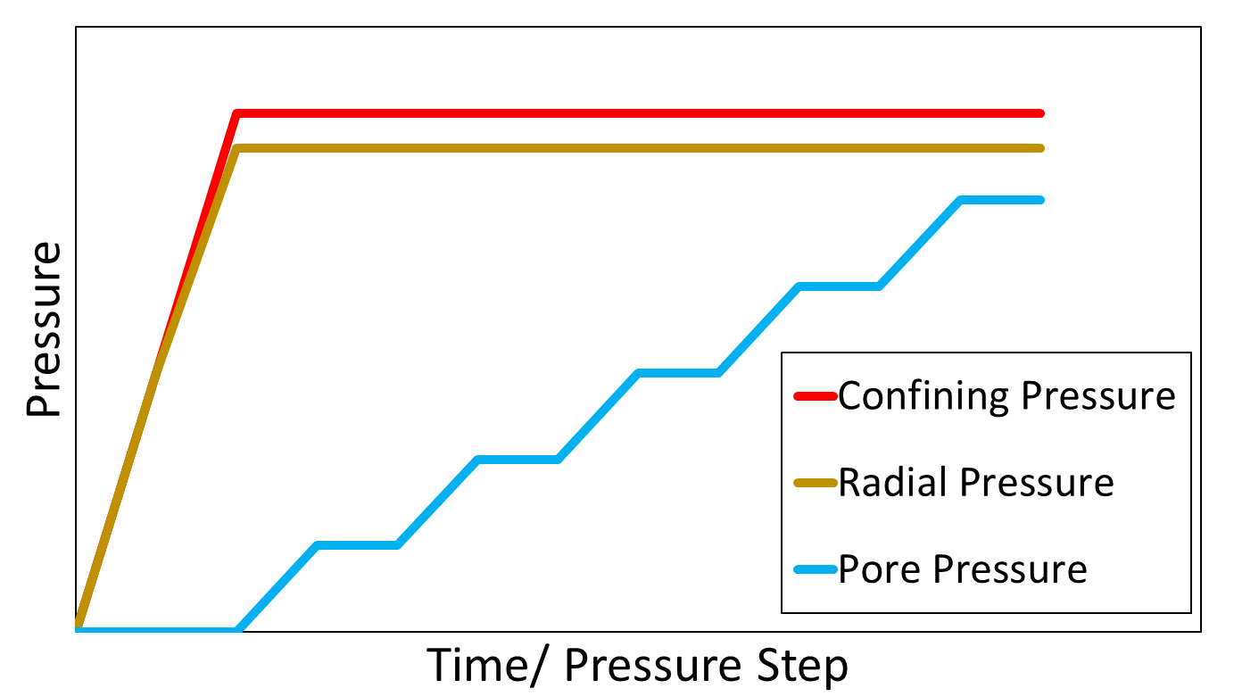
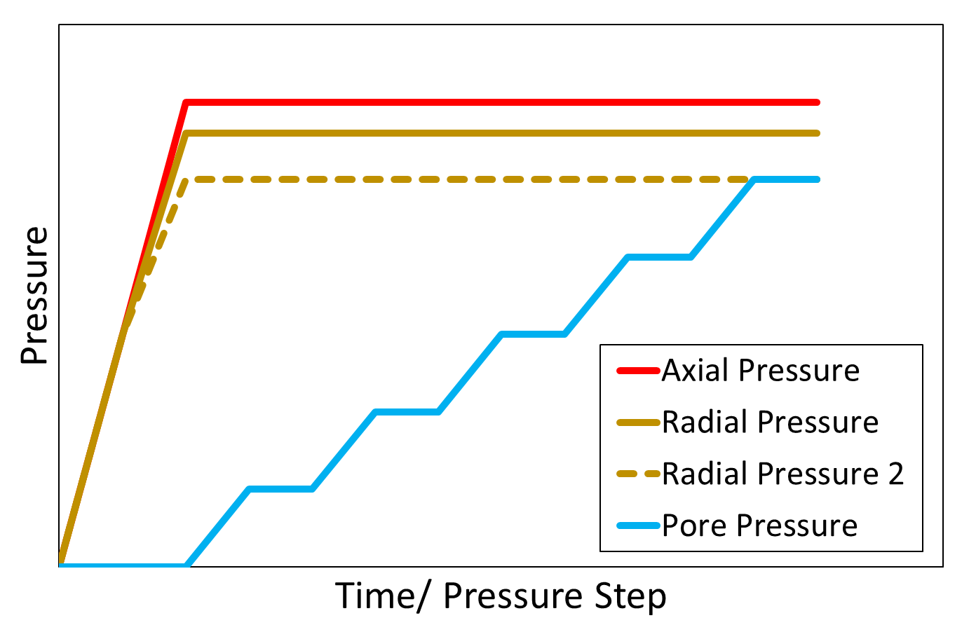
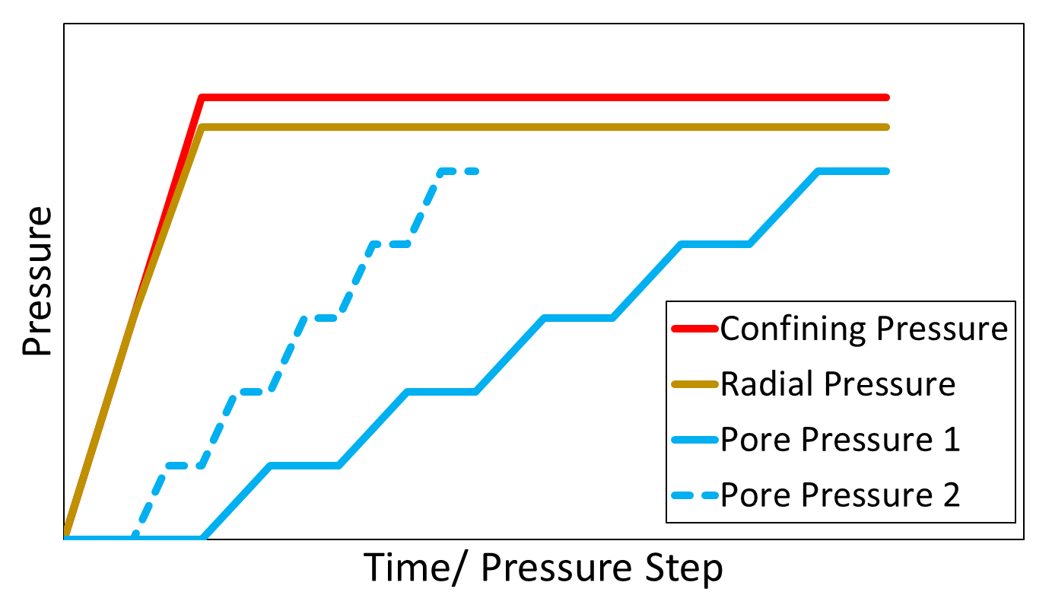
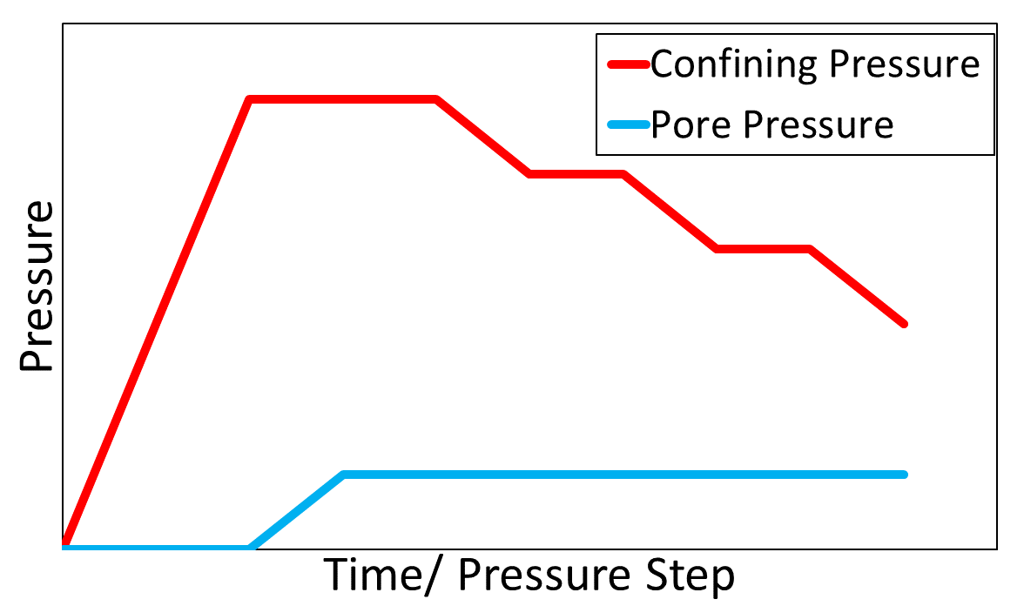
Future Work: Alternate Stress Paths
Current Analysis
Effect of Stress Anisotropy
Rate of Fluid Injection
Erosion

Slide 26
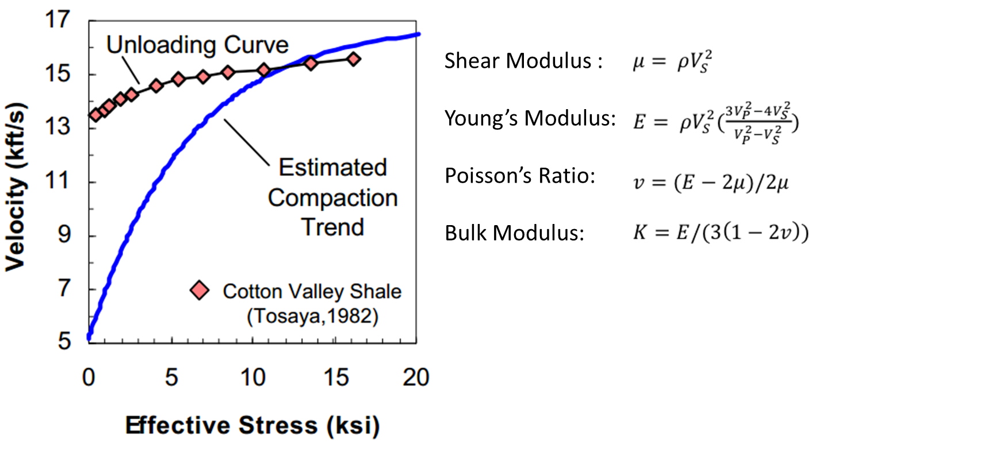
Future Work: Elastic Properties
Mavko et. al, 2009

Slide 27
Conclusions
Pore-scale LBM models replicate realistic porosity-permeability relationships in mudstones
For low overpressures, injected fluid is accommodated as isotropic expansion and parallel to bedding in a dilational/ micro-fracture mechanism – this may be elastic response
As pore pressures approach confining pressure, injected fluid is accommodated perpendicular to bedding by opening of pore throats leading to evolution of high conductivity pathways.
Notes:
Hydraulic fracturing
k trends

Slide 28
Future Work
k-φ relationships in compacted shales upon fluid injection.
NMR experiments to validate correlation between models and injection patterns, and image evolution of pore structure upon fluid injection
Alternate Stress paths to analyze effect of
Rate of fluid injection
Direction of injection w.r.t bedding
Unloading from reducing confining pressure (erosion)
Differential Pressure
Evolution of Elastic Properties to understand change in mechanical properties of rock

